Slide 1


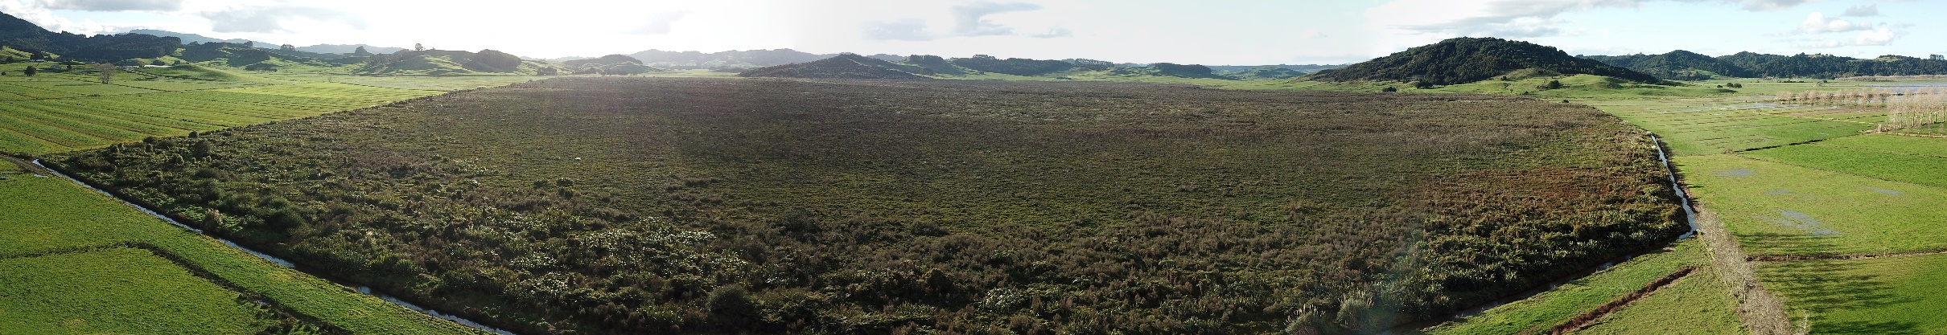
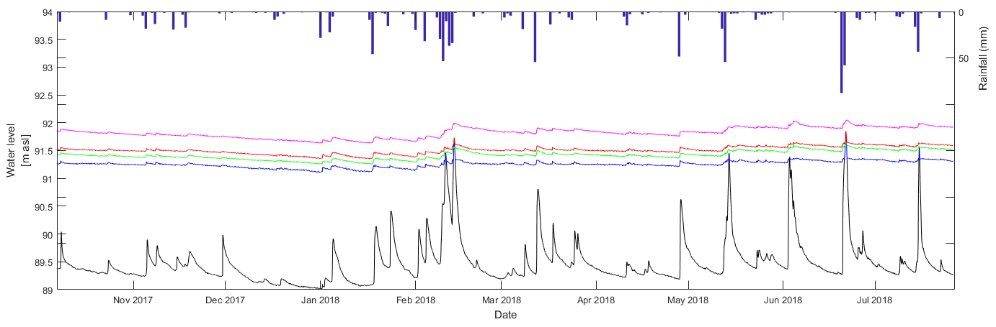

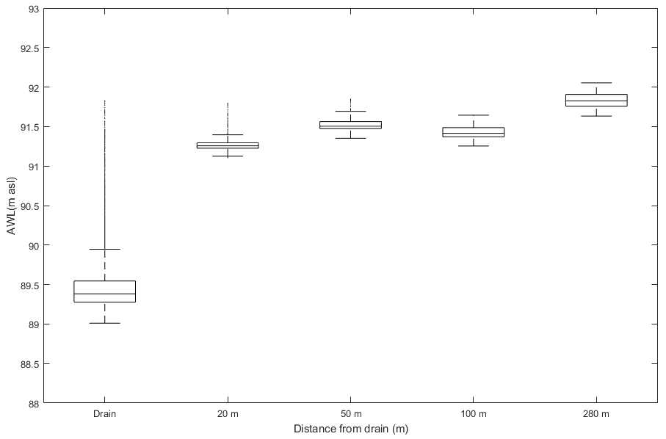
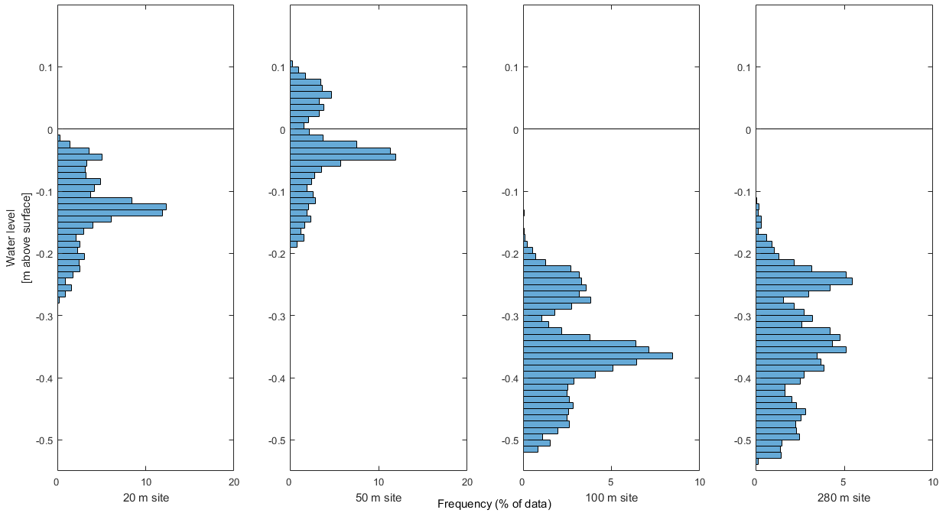
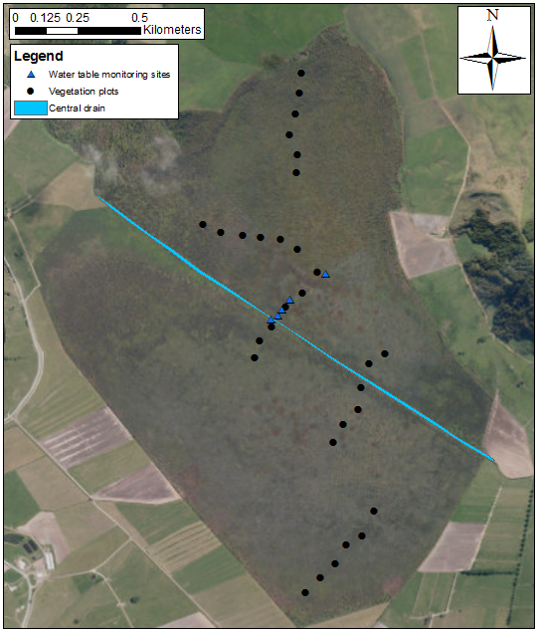
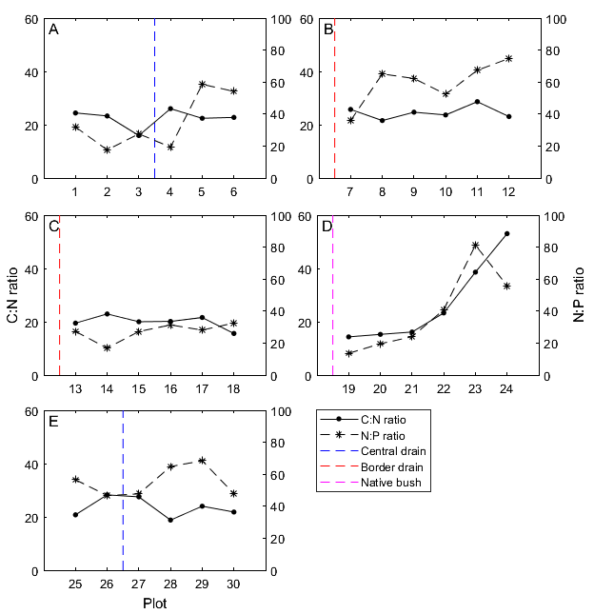
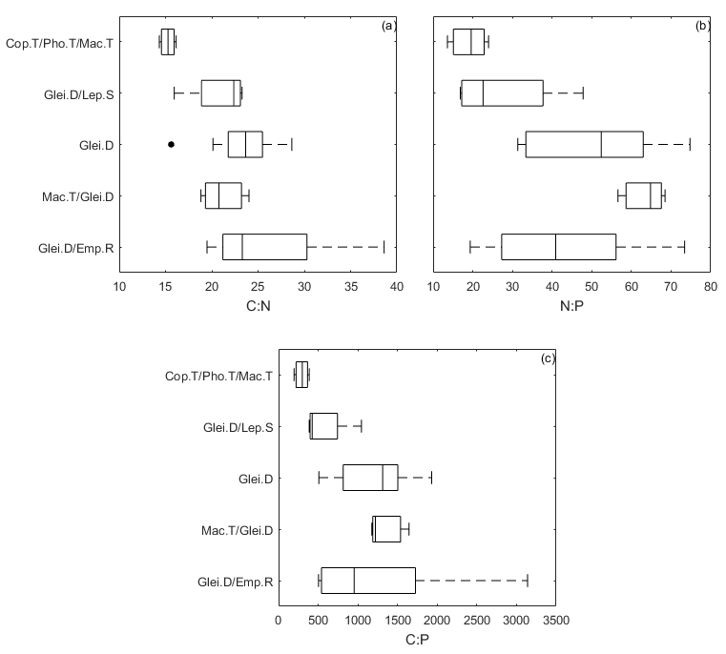
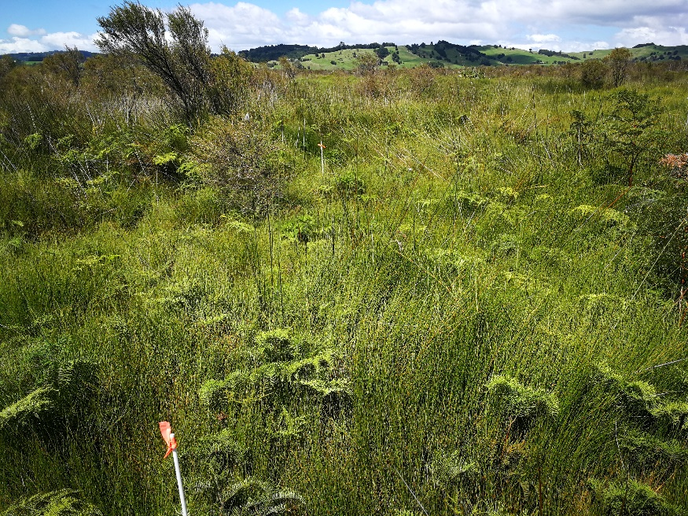
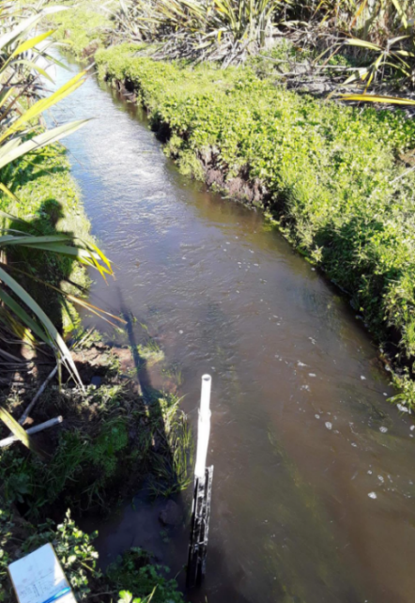
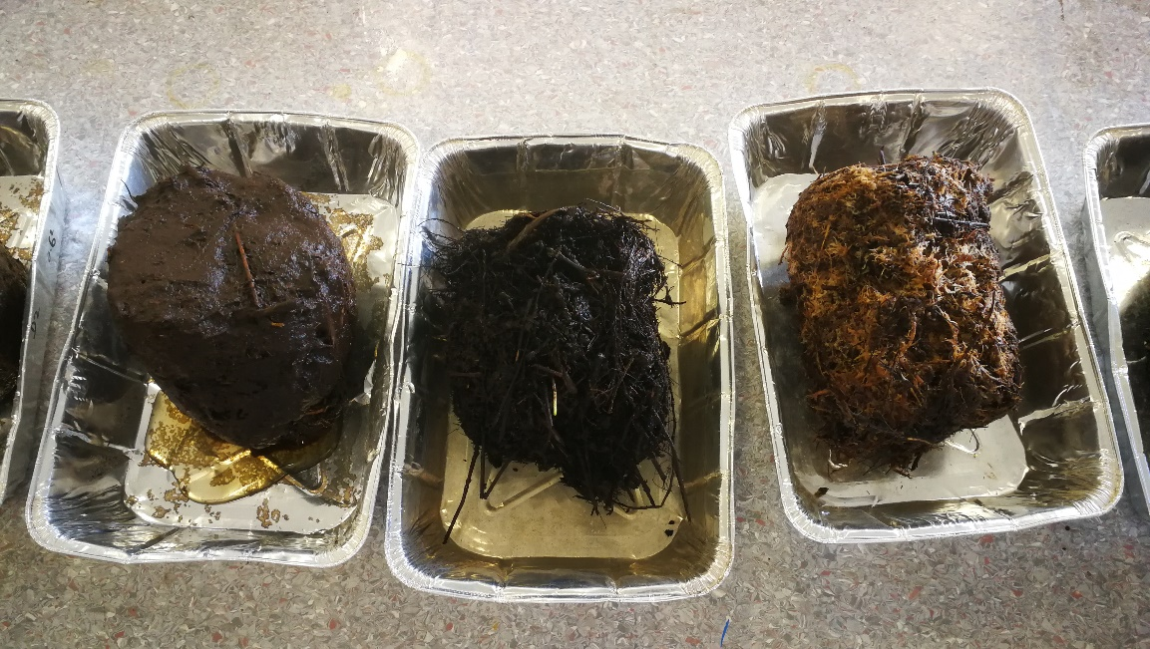
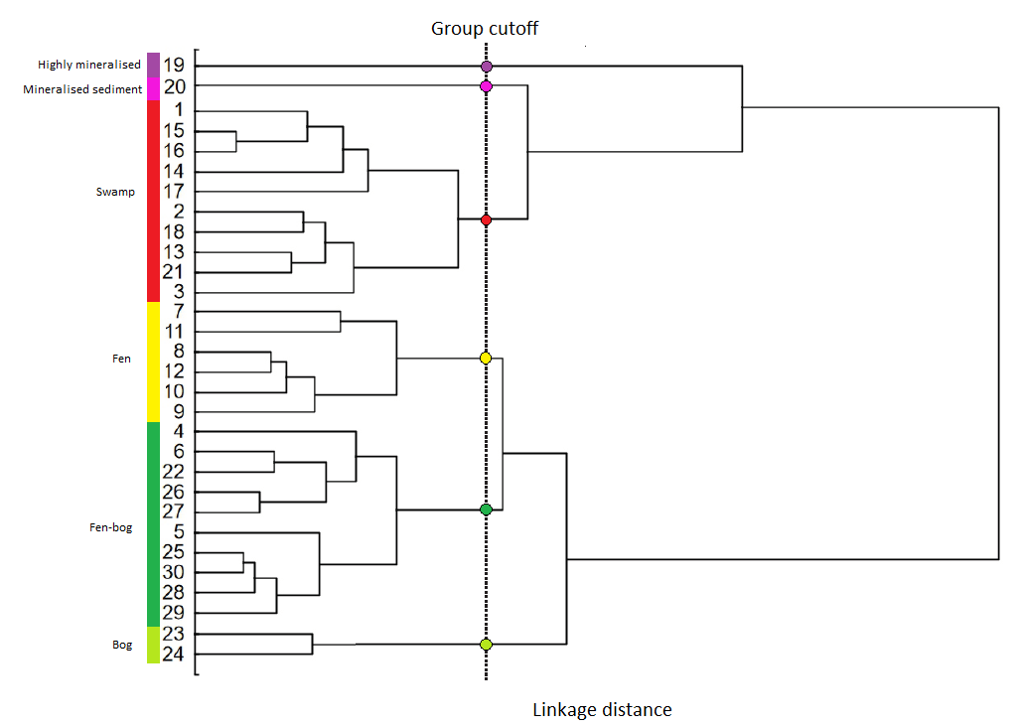
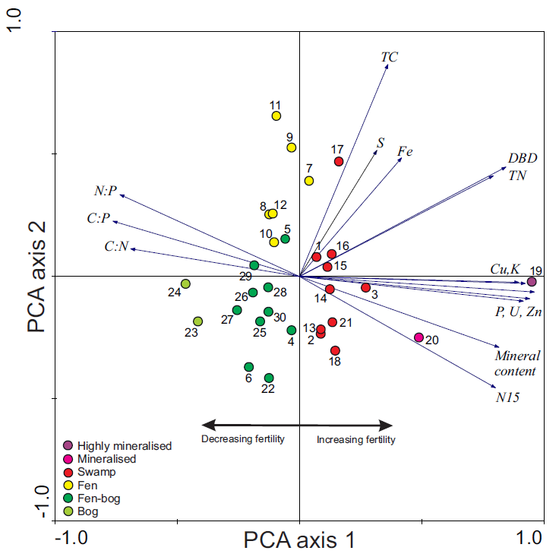
Down the drain:
Measuring the degradation and recovery of a drained wetland remnant
Callum Douglas¹, David Campbell ¹
¹ School of Science, University of Waikato, Hamilton, 3240, New Zealand
INTRODUCTION
RESULTS
Otakairangi wetland is the largest remaining remnant (2.6 km²) of the Hikurangi swamp, a large former wetland complex in Northland.
Past burning events, a large central drain and border drainage separating the wetland from pasture has resulted in severely degraded peat and decreased biodiversity.
There is evidence that the wetland is experiencing natural vegetation recovery.
Our goal was to determine the present day influence of the central drain on wetland condition, and to determine the extent of natural recovery by characterising the ecohydrological functioning.
Hydrology
The drain displays a classic hydrograph with peaks in water level during heavy rainfall events, with normal flows fluctuating by 1 m (total drain range of 2.75 m) (figure 3,4).
During flood events drain water levels inundated the wetland surface to at least 50 m north-east of the central drain (figure 4).
There was a >1.5m gradient between the median drain water level and the median water table at the 20 m site (figure 4).
Normal water table levels sit below the surface for the 20 m, 100 m and 280 m sites, while the 50 m site frequently is inundated up to 11 cm (figure 5).
Figure 3 Hydrologic regime of the 5 water table monitoring sites from October 2017 to July 2018.
SITE AND STUDY DESIGN
Figure 4 Boxplots of site water levels, showing the median, lower and upper quartiles, while dots show outlier values. The green line indicates the surface elevation of each site.
Figure 5 Frequency of normal water table levels relative to peat surface (excludes outlier values).
13
Peat and Vegetation
14
15
16
Higher peat nutrient ratios within the central wetland and southern areas indicates carbon storage (C:N) and phosphorus limitation (N:P) (figure 6).
Lower ratios were seen next to drainage channels where the wetland was frequently inundated, indicating input from external water flows and the associated nutrients (figure 6).
Peat nutrient ratios show correlation to the type of vegetation cover, with plots dominated by Empodisma robustum and Machaerina teretifolia having higher nutrient ratios (figure 8).
The wetland vegetation is primarily dominated by G.dicarpa, with M.teretifolia and L.scoparium generally being secondary species. E.robustum has spread across a wide swath of the wetland and become locally dominant in several areas (table 1).
17
19
20
18
21
22
23
24
6
4
5
3
25
2
26
1
27
28
29
Figure 8 Nutrient ratios (carbon, nitrogen and phosphorus) of peat core samples by dominant vegetation cover. Cop.T = Coprosma tenuicaulis, Pho.T = Phormium tenax, Mac.T = Machaerina teretifolia, Glei.D = Gleichenia dicarpa, Lep.S = Leptospermum scoparium, Emp.R = Empodisma robustum.
(a)
30
Figure 6 Carbon: nitrogen and nitrogen: phosphorus ratios of peat by field plot. Vertical lines indicates the relative position of the disturbances.
(b)
12
(c)
Table 1 Number of vegetation plots dominated by 6 main vegetation species. Primary, secondary and tertiary indicates the relative cover compared to the others.
10
11
8
9
7
Figure 1 (a) Map of the water table monitoring sites and vegetation plots (numbered), with insets showing (b) the vegetation plot at site 24 (c) the drain monitoring site.
Figure 7 Peat cores collected from vegetation plots 19, 12 and 24 (left to right), showing the most mineralised core, a common G. dicarpa core, and a newly formed E.robustum core, respectively.
A network of pressure transducers was installed in August 2017, extending from the central drain into the north-eastern section of the wetland.
Each site contains a single pressure transducer suspended below the water table and anchored to the peat surface.
Raw water level data were compensated using measured barometric pressure.
Peat and vegetation were analysed using 30 (4x4 m) plots over five randomised transects, either extending from or crossing drainage channels.
At each plot field measurements of vegetation communities and peat physical characteristics were undertaken.
Samples of peat, vegetation foliage and groundwater samples were taken at each plot to analyse physical and chemical properties across the wetland area.
Ordinations
Wetland field plots are clustered into 6 main groups that show a fertility gradient from low nutrient, rain-fed bog to frequently inundated and high nutrient swamp (figure 9,10).
Environmental variables used in ordinations include peat physical characteristics, nutrient ratios, and concentrations of metals and other elements (figure 10).
The highest fertility plots were located next to the central drainage ditch, northern drain and the native bush.
Differentiation between the fen and fen-bog group was primarily due to the presence of the vegetation species Empodisma robustum and Machaerina teretifolia.
Figure 9 Tree dendrogram showing the relationships between vegetation plots. derived through ordination techniques.
Figure 10 Principle component ordination (PCA) exhibiting relationships between the 30 vegetation sites across the wetland. Environmental variables are plotted as vectors, with a resultant fertility gradient from left to right. PCA axis 1 explains 60% of the variance, while axis 2 explains 14%.
CONCLUSIONS
Flooding of the central drain during high precipitation events overtoped the drain banks and can move between 50 – 100 m into the wetland on the NE side of the central drain.
The drain did not cause significant water table drawdown beyond 20 m (NE).
Empodisma robustum is located across a wide area of the northern section in small clusters, as well as in a few locations in the southern section, implying natural spread and recovery.
A small area of the wetland shows undisturbed bog-like characteristics, presumably the origin point of the current Empodisma robustum expansion.
ACKNOWLEDGEMENTS
This research was supported by the Fonterra-Department of Conservation Living Water Project, the Enhancing Wetland Ecosystems programme (Manaaki Whenua Landcare Research), and The University of Waikato. We greatly appreciate farm owner Greg Lovell for allowing access through his farm. We also thank Ben Herbert for his assistance in fieldwork, and the regular monitoring of the pressure transducer sites.

